Slide 1
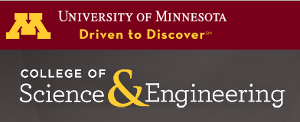
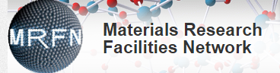
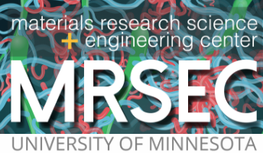
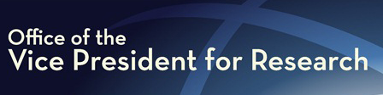
The University of Minnesota
Characterization Facility
Greg Haugstad
Principal Research Physicist and Director
(haugs001@umn.edu and cfac-dir@umn.edu)

Slide 2
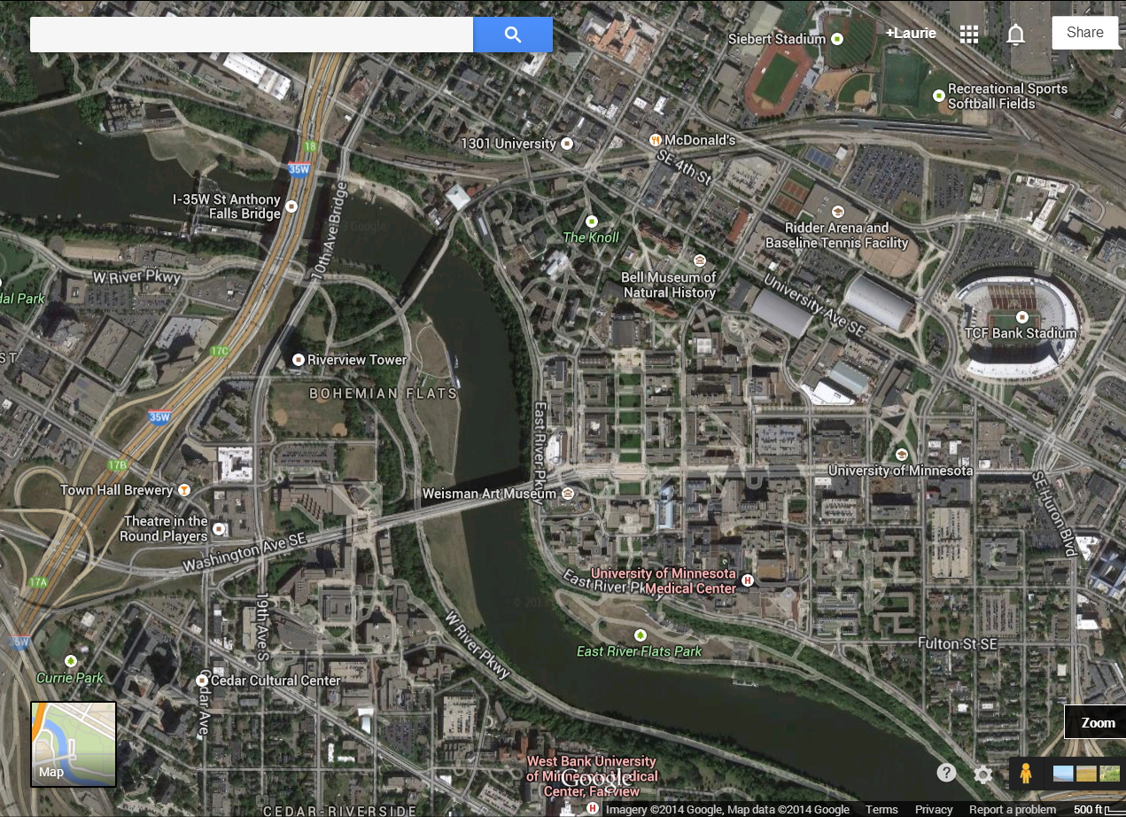
Characterization Facility (CharFac) Locations
University of Minnesota – Mpls campus
MISSISSIPPI
1
Ramp
Ramp
LRT
LRT
Hotel
2
3
Ramp
LRT
RIVER

Slide 3
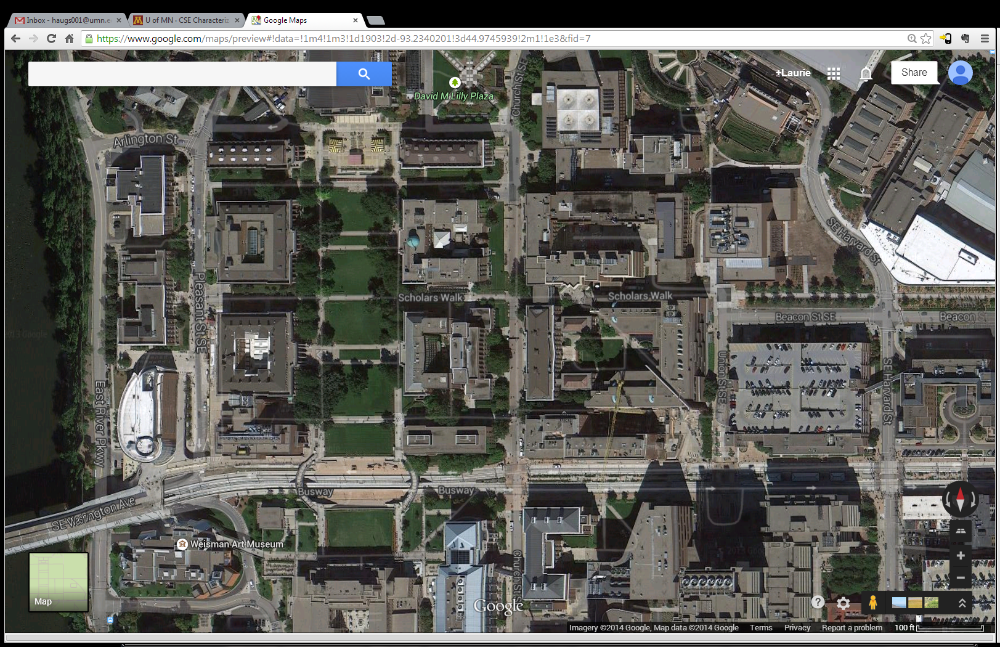
Dunn Brothers
Earth Sciences
University of Minnesota
East Bank Campus; 3 CharFac Locations
Northrup
Auditorium
MISSISSIPPI
RIVER
Civil, Env. & Geo. Eng.
1.
Shepherd Labs
MALL
Sci. & Eng. Library
Mech. Eng.
Aerosp. Eng.
Physics 1
Physics 2
/ Nano
Rec./Health Club
Wise Owl Cafe
Chemistry 1
Inst. Math &Appl.
Starbucks
Electr. Eng.
Washington Ave. Parking Ramp
Commons Hotel ****
Chemistry 2
*
Chem. Eng.
& Mat. Sci.
Starbucks
LRT station
Pharma.
Starbucks
Genetics
Cell Biol.
Devel.
Biochem. Molec. Biol.
Biophys.
Caribou Coffee
Weisman Museum
Biomed. Eng.
Inst. Molec. Virology
Coffman Union; Einstein Brothers
2. Nils Hasselmo Hall
3. Moos Tower
Freshii

Slide 4
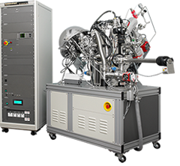
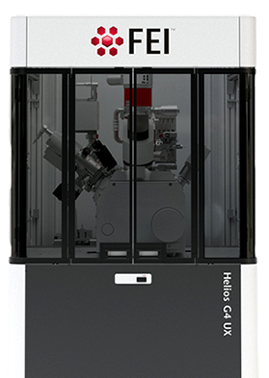
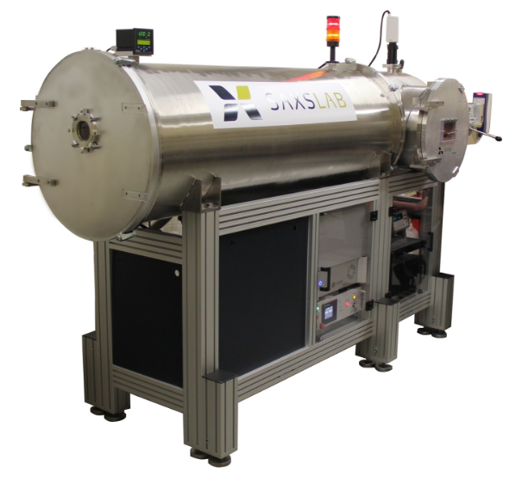
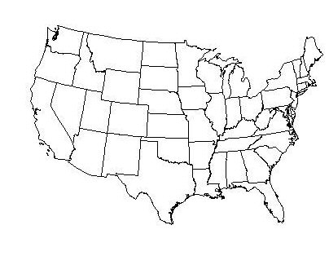
University of Minnesota Characterization Facility
>$20 million of equipment (replacement value)
Electron microscopes: 6 TEM, 5 SEM/FIB, cryogenic/analytical
X-ray scattering: 7 wide-, 1 small-angle, 2 micro, variable Temp
Proximal nanoprobes: 4 AFM, STM, profilom., 4 indentors
Surface analytical: XPS/UPS/Auger, sputter, microtensiom.
Chemical spectro/microscopy: confocal Raman, FTIR/ATR
Thin film analysis: RBS w/PIXE/FReS, spectrosc. ellipsom.
~11 FTE scientific staff (permanent)
~600 research users/yr, ~100 external
~135 faculty users from ~35 UMN departments/units
~250 students/yr in curricular classes & short courses
~50 companies per year
~20 external academic
institutions per year
Newest systems
XPS, UPS, cluster beam
Dual-beam FIB/SEM
Small-angle X-ray scattering
Hard & soft materials, liquids, bio/medical, enviro/geo/anthro
Expert analytical services, custom methodologies
External collaborations
Workshops & short courses
Clientele: “Like a national lab”
www.charfac.umn.edu
Other pertinent facilities on campus:
State-of-the-art light microscopy (superresolution, etc.) → University Imaging Center
Rheology/DSC/TGA, NMR, Mass spectrom., X-ray tomography/electron microprobe
Micro-/Nano-fabrication, Bioprocessing (fermentation, etc.)

Slide 5
Motivations in CharFac’s industry collaborations
Increase understanding of, proficiency with, analytical methods,
(whether new modalities or ones we have not used much, or
correlative methods, i.e., multiple techniques).
Develop new analytical methodologies, expand utility. (thereby attract users / clients / collaborators)
Obtain interesting / challenging samples. (We are analytical scientists not synthesists or engineers.)
Provide a technological context for methods research (synergistic with proprietary work we do).

Slide 6
CharFac Technical Staff
Electron microscopy
X-ray scattering
Proximal probes
Vibrational spectroscopy
Surface Analytical
Thin film analysis
13 professionals (11.3 FTE) manage 3-site capabilities.
Includes expert analytical services, education/training, assistance/consultation, methods development, collaboration.
Chris Frethem | SEM (cryo and bio/soft material emphasis)
Dr. Javier Garcia-Barriocanal | XRD, Small-angle X-Ray scattering, IBA
Dr. Bob Hafner | High-contrast and cryo TEM (bio, soft materials emphasis)
Dr. Greg Haugstad | AFM, Ion beam analysis (IBA: RBS, PIXE, FReS & related)
Dr. Jong Jeong (0.15 FTE) | Titan TEM
Dr. Han Seung Lee | SEM/TEM (cryo emphasis), Small-angle X-Ray scattering
Dr. Bing Luo | Confocal Raman/FTIR, XPS, micro-contact angle, Auger
Dr. Jason Myers | FEG-TEM (HR/STEM/EDS/EELS), FIB
Dr. John Nelson (0.1 FTE) | Nano/micro-mechanical, stylus profilometry
Dr. Geoff Rojas | Auger, UPS/XPS, STM/AFM, TEM
Dr. Nick Seaton | SEM (hard materials emphasis), FIB, EDS/EBSD/cathodolum.
Dr. Seema Thakral (0.6 FTE) | XRD, Small-angle X-Ray scattering
Dr. Wei Zhang (0.45 FTE) | Cryo FEG-TEM, 3D reconstruction, tomography
Fang Zhou, MS | Bio EM specimen prep, (cryo)microtomy, TEM (bio, soft material)
Contact Information at www.charfac.umn.edu/staff

Slide 7
Modern needs for broadly talented and highly engaged staffing
(i.e., beyond default management of equipment and provision of basic training)
Broadly talented: Expertise in
  correlative methods including imaging, spectroscopy, and/or others (e.g., mechanical) that co-register datasets combining disparate information;
  hyperspectral imaging – spectral data interlaced with imaging within a single instrument);
  data management and informatics to handle orders-of-magnitude larger datasets (“big data”);
  advanced data analytics (e.g., principal component analysis) and extending in some cases to the supercomputer regime (e.g, 3D reconstruction from TEM);
  computer programming to expand capabilities whether on the measurement side (e.g., LabView, python scripting,…) or data processing/analyzing side (e.g. matlab, origin, visual basic,…).
Highly engaged: Staff scientists who are proficient (and sought) as consultants, mentors, and collaborators, to propel the usage of increasingly advanced analytical tools to higher levels. Get past early-1990's paradigm of having grad students receive only novice levels of training and correspondingly use techniques at “austere” levels of creativity and understanding. (Justify state-of-the-art, multimodal instruments in core facilities, not just in single-PI labs that groom analytical experts as explicit components of their theses.)

Slide 8
What to encourage and enable with expert staff
Nurture academia-based scientists as
Stewards of capabilities as presumed; actual time on instrumentation to
  ensure fully functional and optimized performance;
  continually upgrade capabilities;
  prevent (or mitigate) abuse;
  catalyze advanced usage by more than just the staff.
Actual practitioners – greater emphasis on developing expertise than on grant writing, supervising, meetings, administrative tasks
Actual mentors and educators
  sufficient facetime with trainees, in the context of their research;
  contributions to the formal curriculum/practicum, such that it utilizes core-staff expertise and does not shortchange analytical education
  Actual scholars
  opportunities to flourish as writers, whether in primary journal articles, reviews, book chapters, monographs (or all of the above)
  ample time to serve in peer review – improve the state of measurement science as reported in the literature

Slide 9
Professional credit, development, visibility
Co-authorship
  Lead scientist/intellect behind a portion of the analytical research in a given publication; most “answerable” to the technical community.
  Provide proper presentation of measurement science to ensure validity and reproducibility.
  Ensure that the name responsible for generating and analyzing data is contained in future citations (i.e., not in the acknowledgments).
Independent scholarship
  Communicate the unique perspective of a hands-on experimentalist.
  Develop and publish special analytical methods.
  Generate methods chapters or monographs to be used in education.
Conference, workshop and short course presentations
  Assign a face to who has done the work, where the intellect resides.
  Provide a venue for practitioners to exchange know-how and advance their collective domain of analytical science.
  Foster interactions that lead to new collaborations, trainees or contract work, to improve a facility’s bottom line.

